Slide 1
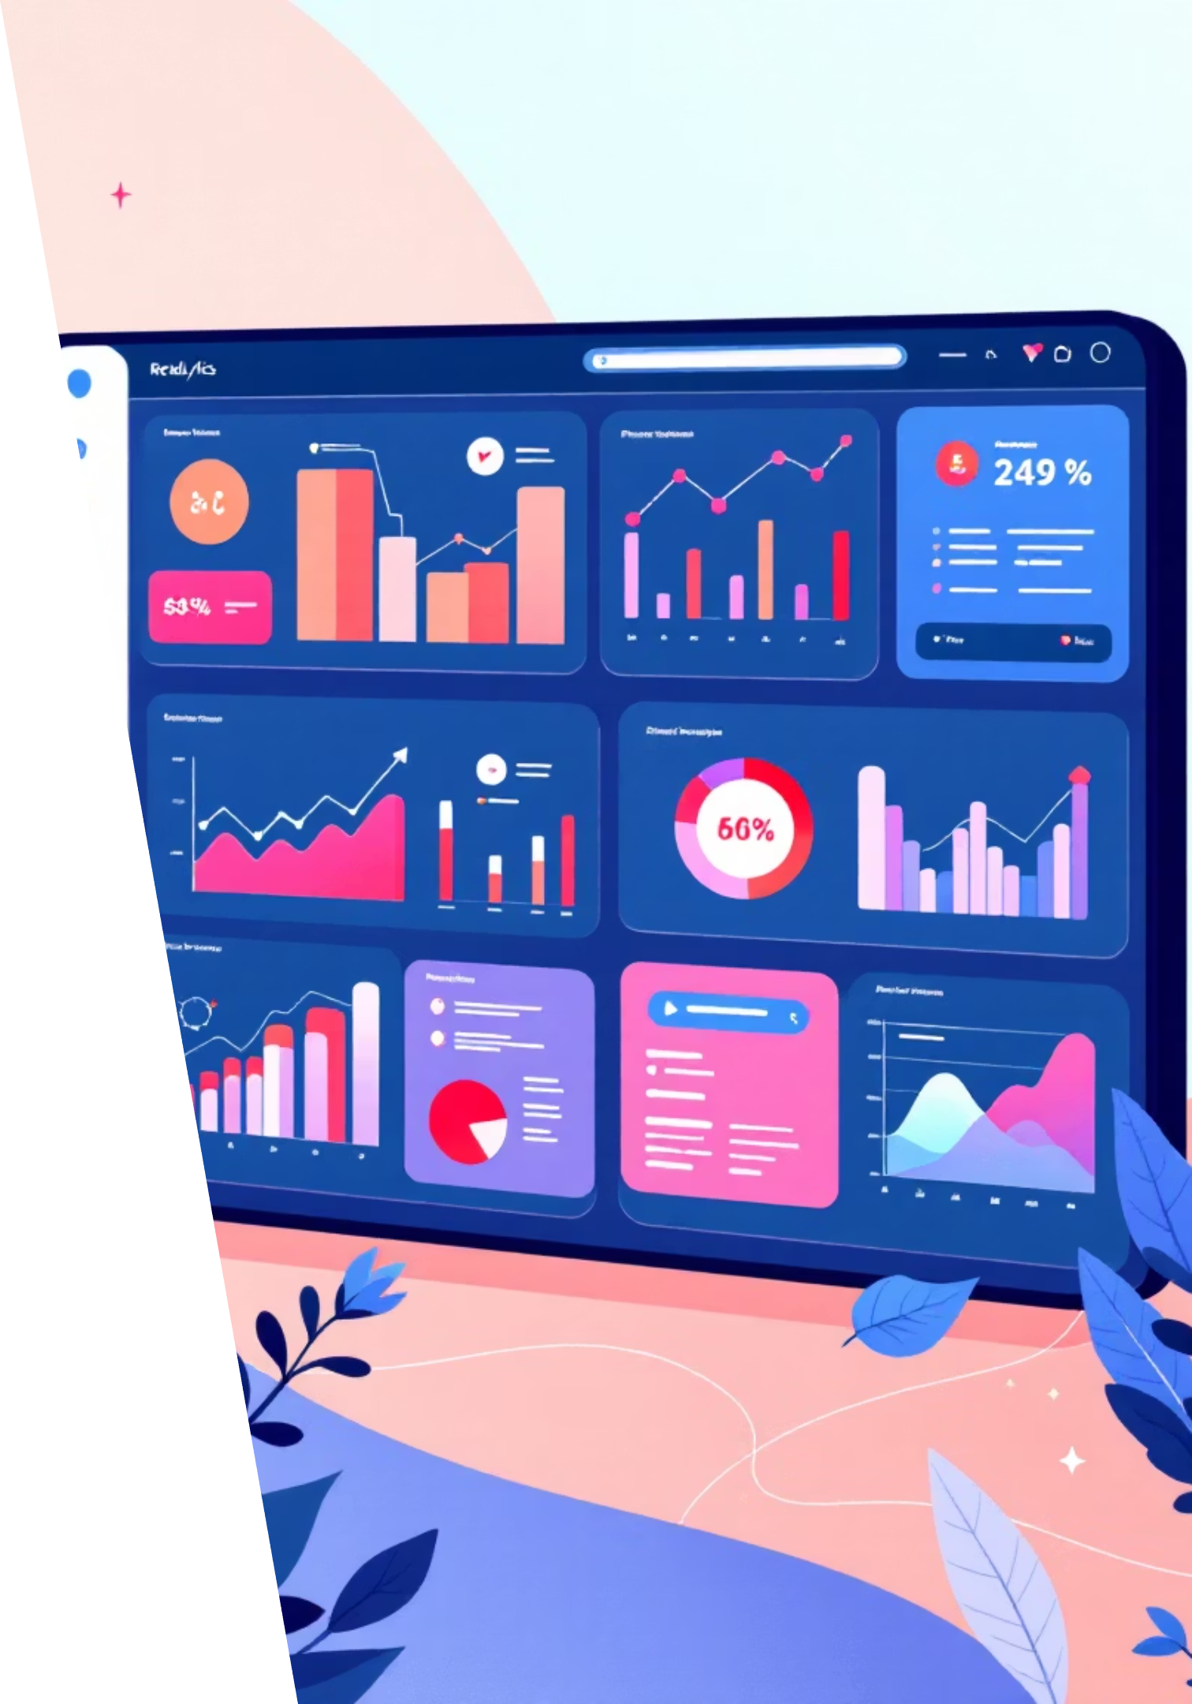
Customer Shopping Behavior Analysis
Uncovering insights from 3,900 purchases to drive strategic business decisions

Slide 2

Dataset at a Glance
3,900
18
50
25
Total Purchases
Data Points
Locations
Products
Transactions analyzed across all categories
Features tracked per customer
Geographic coverage
Unique items purchased

Slide 3
Python Data Preparation
01
02
Data Loading & Exploration
Missing Data Handling
Imported dataset, checked structure with df.info() and summary statistics
Imputed 37 missing Review Ratings using median by category
03
04
Feature Engineering
Database Integration
Created age_group bins and purchase_frequency_days columns
Connected to PostgreSQL for advanced SQL analysis

Slide 4
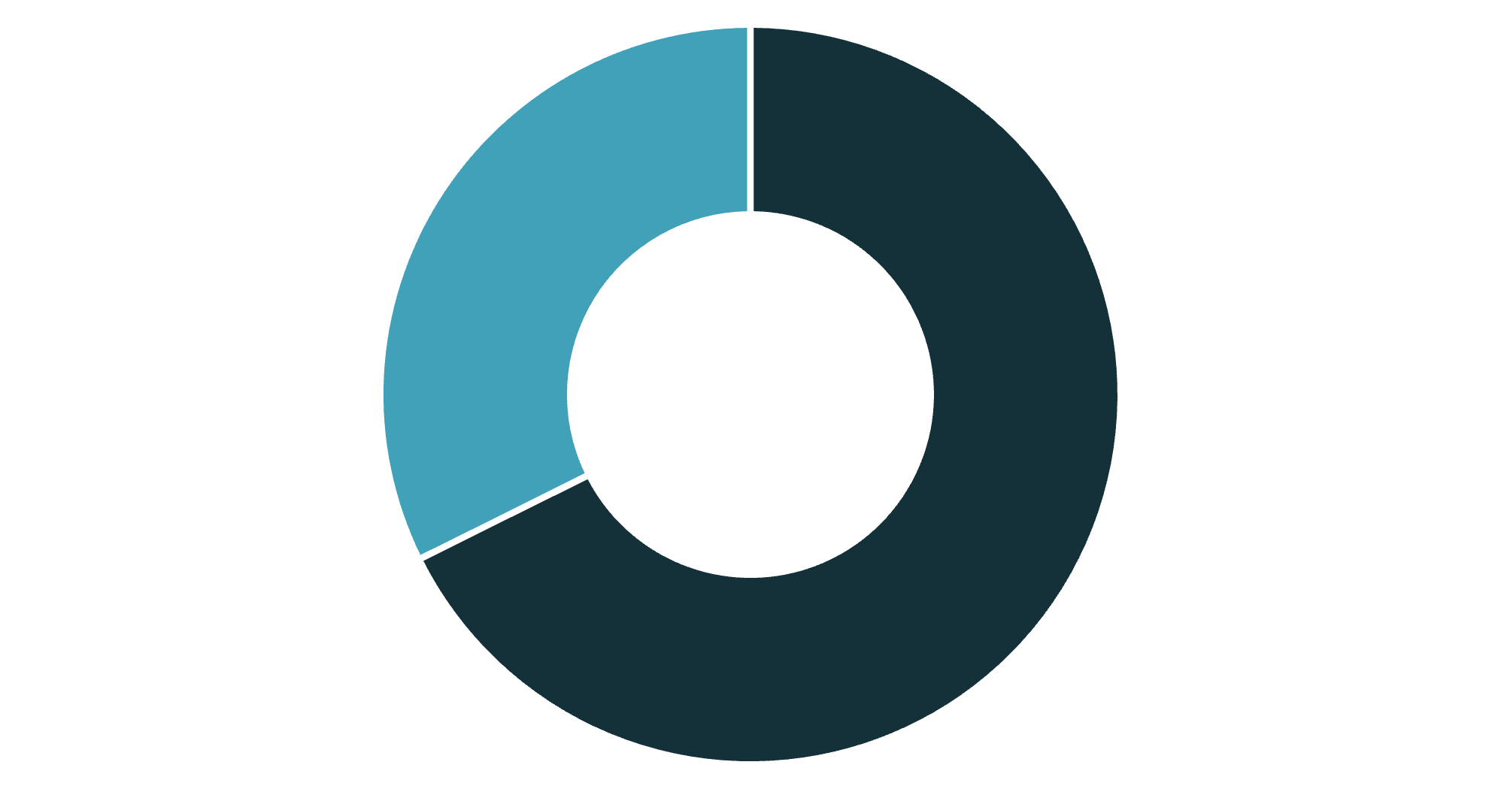
Revenue by Gender
Male Customers Drive Revenue
Male customers generate 68% of total revenue
Female segment represents significant growth opportunity
Male
Female

Slide 5

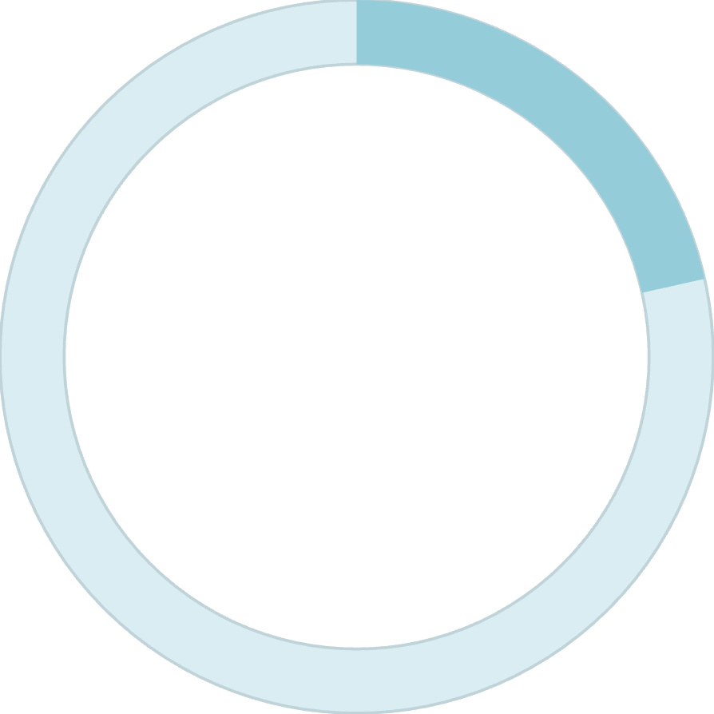
Smart Discount Users
839
21.5%
High-Value Discount Shoppers
Segment Size
Customers using discounts while spending above average
Of total customer base
These customers prove discounts don't always mean lower margins

Slide 6






Top-Rated Products
Gloves
Sandals
Boots
Rating: 3.86
Rating: 3.84
Rating: 3.82
Hat
Skirt
Rating: 3.80
Rating: 3.78

Slide 7
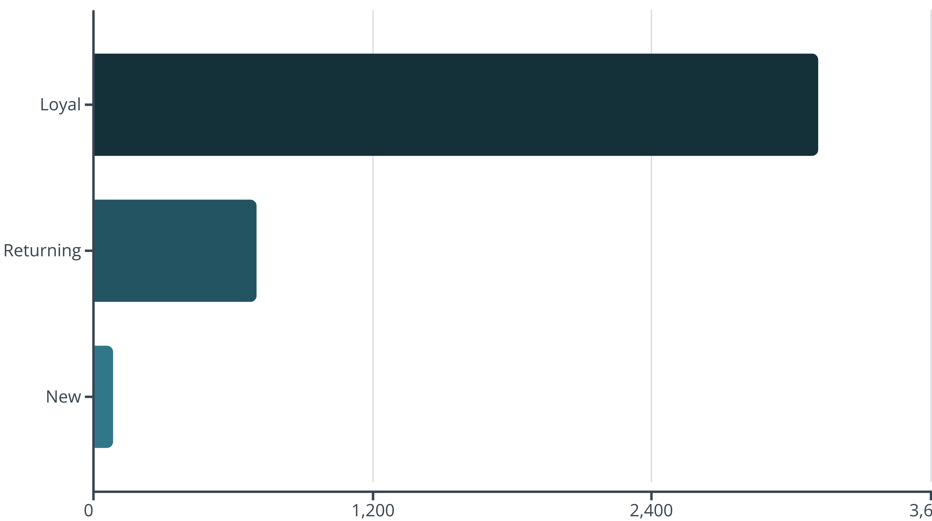
Customer Loyalty Segments
80% of customers are loyal - strong retention foundation

Slide 8


Subscription Insights
Subscribers vs Non-Subscribers
1,053 subscribers generating $62,645
2,847 non-subscribers generating $170,436
Similar average spend: $59.49 vs $59.87
Repeat buyers (>5 purchases): 958 subscribers vs 2,518 non-subscribers
Opportunity: Convert repeat buyers into subscribers with exclusive benefits

Slide 9
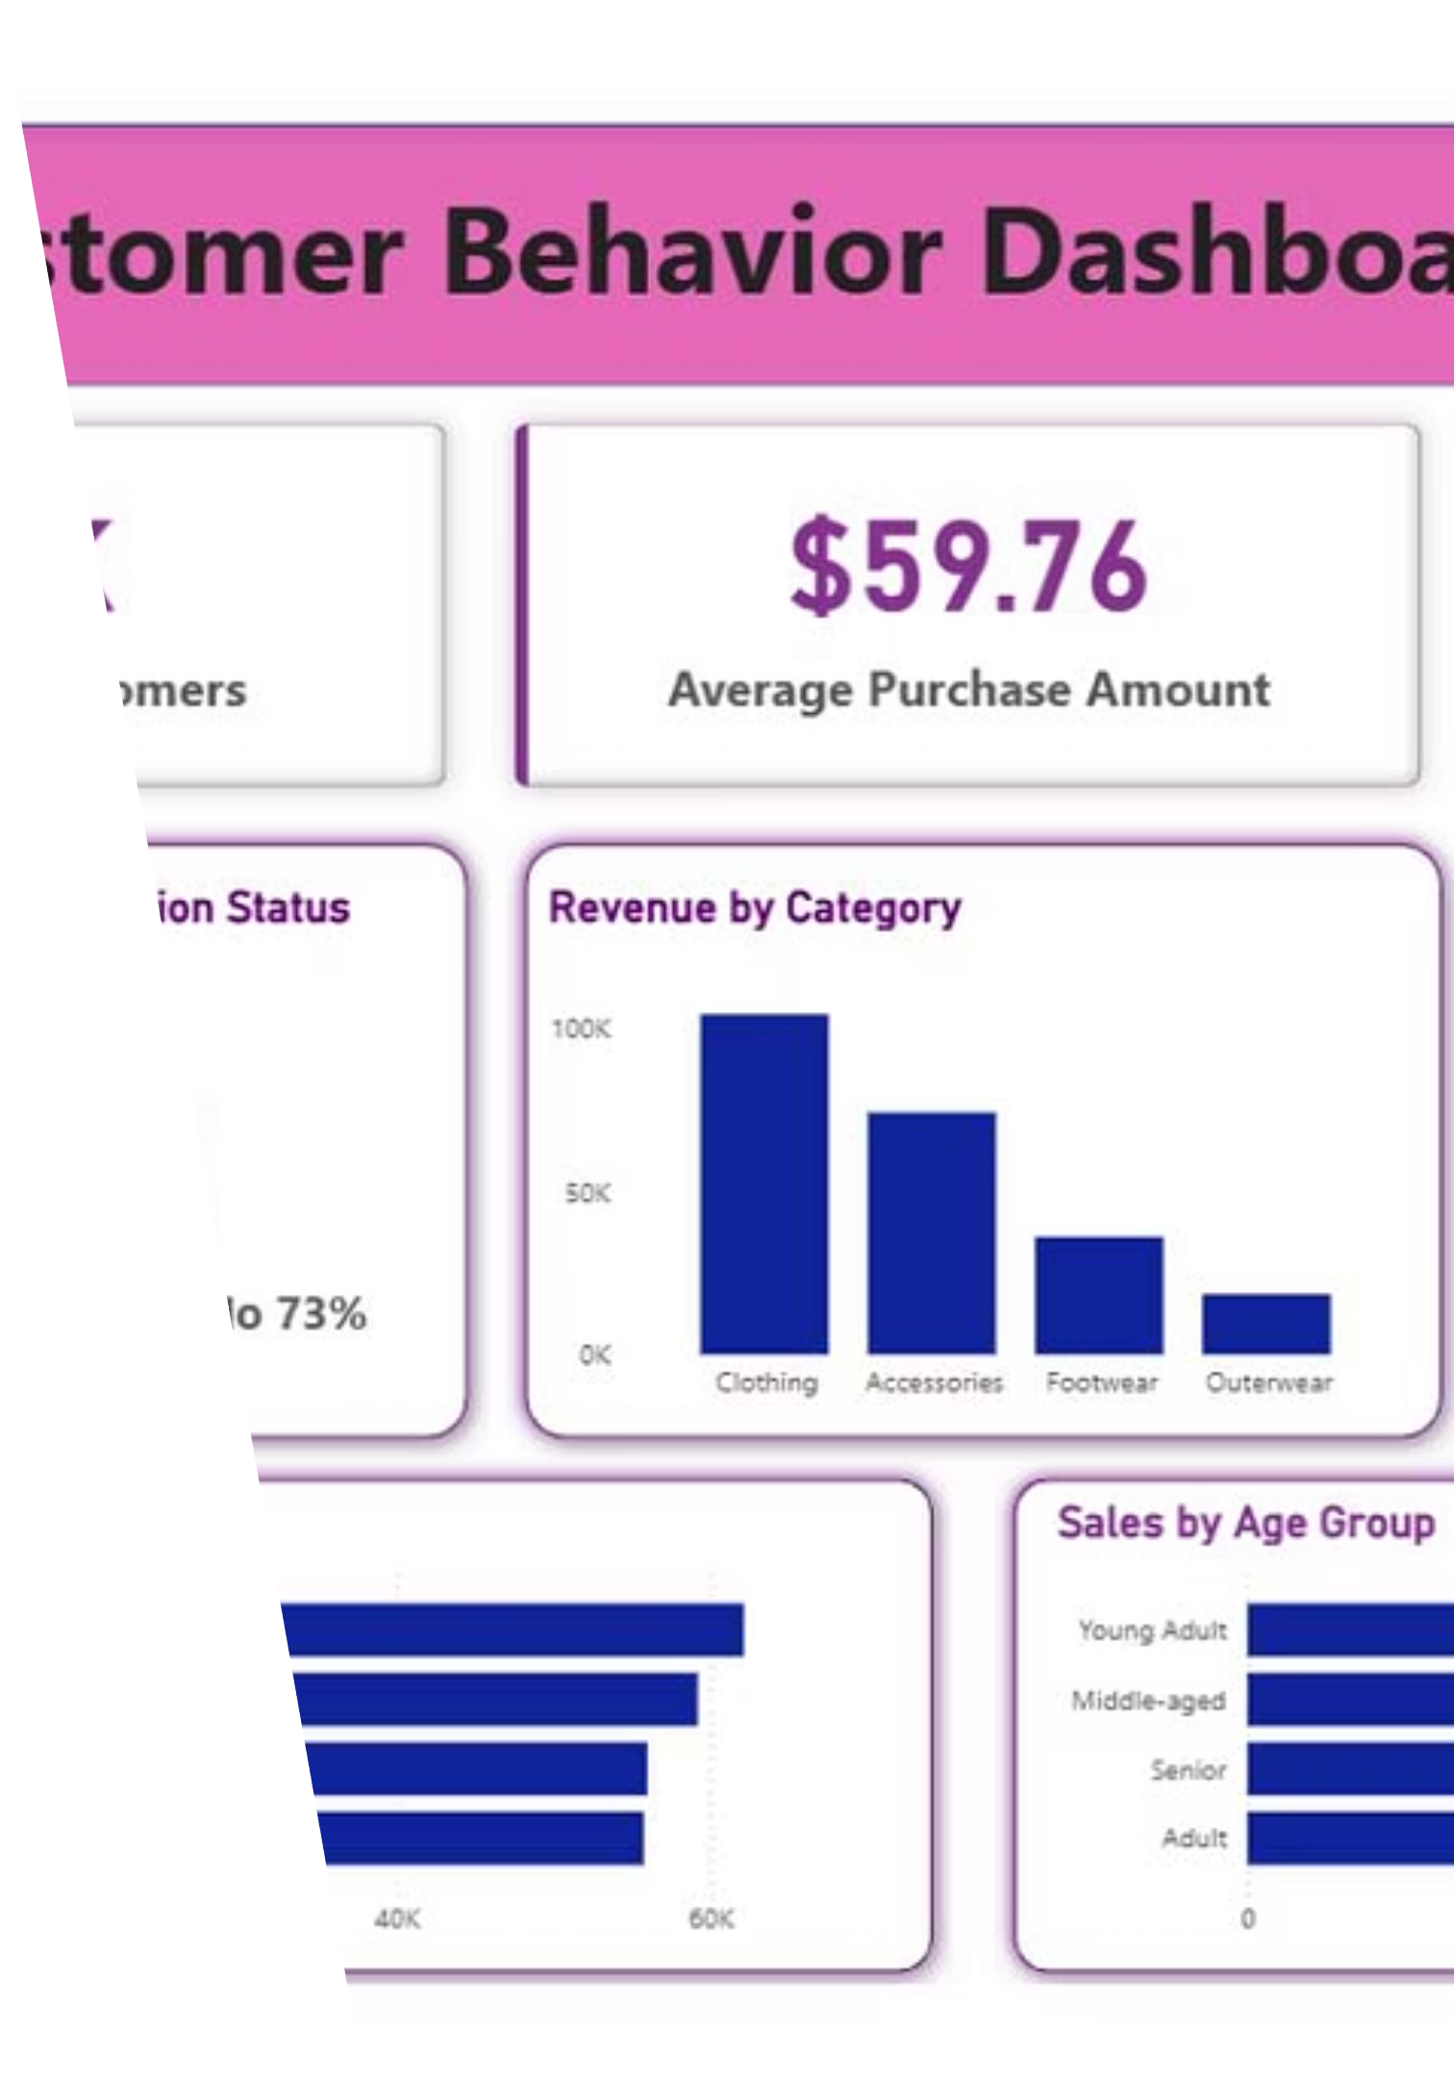
Power BI Dashboard
Interactive visualization bringing all insights together for real-time decision making

Slide 10
Strategic Recommendations
Boost Subscriptions
Loyalty Programs
Review Discount Policy
Promote exclusive benefits to convert repeat buyers
Reward repeat buyers to strengthen loyal segment
Balance sales growth with margin control
Product Positioning
Targeted Marketing
Highlight top-rated items in marketing campaigns
Focus on high-revenue age groups and express shipping users

